Slide 1
Provost’s Task Force on
Inclusion and Engagement of International Students at UB
Peter F. Biehl
Task Force Chair
Chair of the Council on International Studies and Programs (CISP)

Slide 3
Outline
Timeline
Quick Facts – Task Force on Inclusion and Engagement of International Students
Key Recommendations
Next Steps and Implementation
Q &A

Slide 4
Timeline
Presentations and Feedback
11/2014 Forming of the Task Force
10/2015 Council on International Studies and Programs (CISP)
12/2015 Center for Studies in Higher Education UC Berkeley
04/2015 Council on International Studies and Programs (CISP)
05/2016 Submission of the Task Force Report
10/2016 Faculty Senate Executive Committee
02/2017 Association of International Education Administrators Washington DC
02/2017 Forming of the Implementation Committee
04/2017 Faculty Senate Executive Committee

Slide 5
Task Force Membership:
Peter Biehl (Chair, Anthropology)
Stella Batalama (Electrical Engineering)
Tilman Baumstark (Faculty Affairs)
Chris Bragdon (ISSS)
Janina Brutt-Griffler (School of Education)
Yu-Ping Chang (Nursing)
Andrea Costantino (Campus Living)
Colleen Culleton (The Academies)
Diane Dittmar (Management)
Ellen Dussourd (Director of ISSS)
Sandra Flash (Academic and Student Affairs)
Lindsey Hallman (Undergraduate Education)
Graham Hammill (Graduate School)
Christine Human (Engineering)
Wei Loon Leong (Alumni Affairs)
Teresa Miller (Equity and Inclusion)
Erin O’Brien (Management)
Keith Otto (ESL)
Mulchand Patel (Biochemistry)
Shannon Phillips (Architecture)
Jessie Poon (Geography)
Gina Prescott (Pharmacy)
Barbara Ricotta (Student Affairs)
Joseph Schneider (Law School)
Korydon Smith (Architecture)
John Stone (Public Health)
Cheryl Taplin (Student Success and Retention)
Carol Van Zile-Tamsen (Center for
Educational Innovation)
Hilary Weaver (Social Work)
Lauren Young (Institutional Analysis)

Slide 6
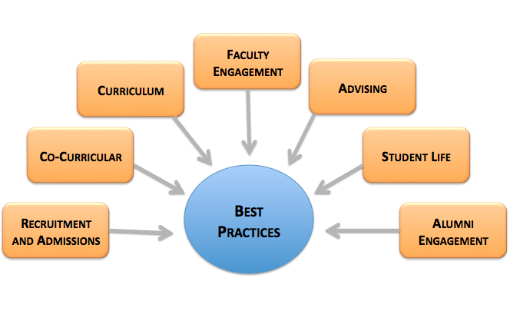
The Charge

Slide 7
The Methodology

Slide 8
Timeline

Slide 9
54 Key Recommendations
12 recommendations that would require funding (A1-12; report page 58-60)
39 recommendations that would not require funding (B1-39; report page 60-65)

Slide 10
Selection of Key Recommendations
University leadership should communicate that international students are valued (B5)
All units should include internationalization efforts as part of their strategic plans (B6)
Full time staff member/s to oversee international student integration (A2)
Review current staffing levels and research staffing at peer institutions, and increase counselors dedicated to international student career needs, staff to focus on outreach to employers and engagement of the international alumni, accordingly (A3 and A4)
Strengthen academic support services for international students and UB's Center for Excellence in Writing (A5)
Provide a forum where UB decanal units who are making the greatest strides in including and engaging international students can share their best practices (A7)

Slide 11
Selection of Key Recommendations
Develop a year-long workshop series to be developed jointly between the Center for Educational Innovation, the Office of International Student and Scholar Services, and Faculty Affairs on topics related to international student education and effective communication strategies, with tools for faculty to include in teaching and assessment that positively impact learning outcomes (A8)
Survey findings of the international students survey should be accessible to faculty so they are culturally aware of the impact of their interactions with international students (A11)
Encourage the inclusion of international student needs in university-wide tutoring initiatives. Provide resources to decanal and service units so they can fund GAs to support discipline-specific peer mentoring and tutoring programs (A12)

Slide 12
Selection of Key Recommendations
Creating a social media space, for example a social forum website, for faculty and instructors to share pedagogical approaches that are successful (A10)
Create a central website for faculty with information and links to all resources and support services available for students, both domestic and international, and faculty (A9)
Provide accurate, helpful information for international students in UB’s centralized Content Management System (CMS) so that UB decanal units and departments can download it for their Resources Guides or feed it to their websites (B8)
An expanded website for off-campus housing with a more comprehensive database of rental properties and landlord contact information / reviews was suggested (B20)
Require all on campus jobs to be posted through Bullseye- job site hosted by UB Office of Career Services (B31)

Slide 14
Next Steps

